Slide 1
NLP Application
Topic modeling +Sentiment analysis
Group 3.
Notes:
Good afternoon everyone, we are group 3. Today I will talk about a natural language processing application using topic modeling and sentiment analysis techniques.

Slide 2
Content
1. Problem Statement
2. Datasets
3. Data Cleaning
4. Select relevant data
5.Topic modeling
6. Sentiment analysis
7. Conclusion
Notes:
There are seven sections in my presentation, firstly, I will introduce our problem statement and datasets.
After, I will talk about the data cleaning process, specifically, the text cleaning procedure.
The fourth is the selection of relevant data,
and then is the topic modeling and sentiment analysis.
After all of that, we will talk about the conclusions we get.

Slide 3

1/7 Problem Statement Introduction
Our goal is to look at comments of various tech companies and note their similarities and differences. Specifically, I'd like to know if the Five tech giants are different than other companies, since they shared most of the market
Notes:
The problem we want to solve is to gain some insights of tech companies such as Microsoft, Apple, Google etcetera (etc) by looking at the comments by employees and tweets.
Specifically, I'd like to know if the Five tech giants are different from other companies since they shared most of the market.

Slide 4
1/7 Problem Statement Steps
Topic modeling
Topic relating to these company on tweets
Sentiment analysis
Do people hold a positive altitude to the companies?
Visualization
Find clues for the companies’ success.
Notes:
So, basically, there are three main steps.
Use topic modeling to find out what they are talking about on tweets
Use sentiment analysis to identify the positive or negative sentiment of comments
Find out some clues for companies’ success

Slide 5
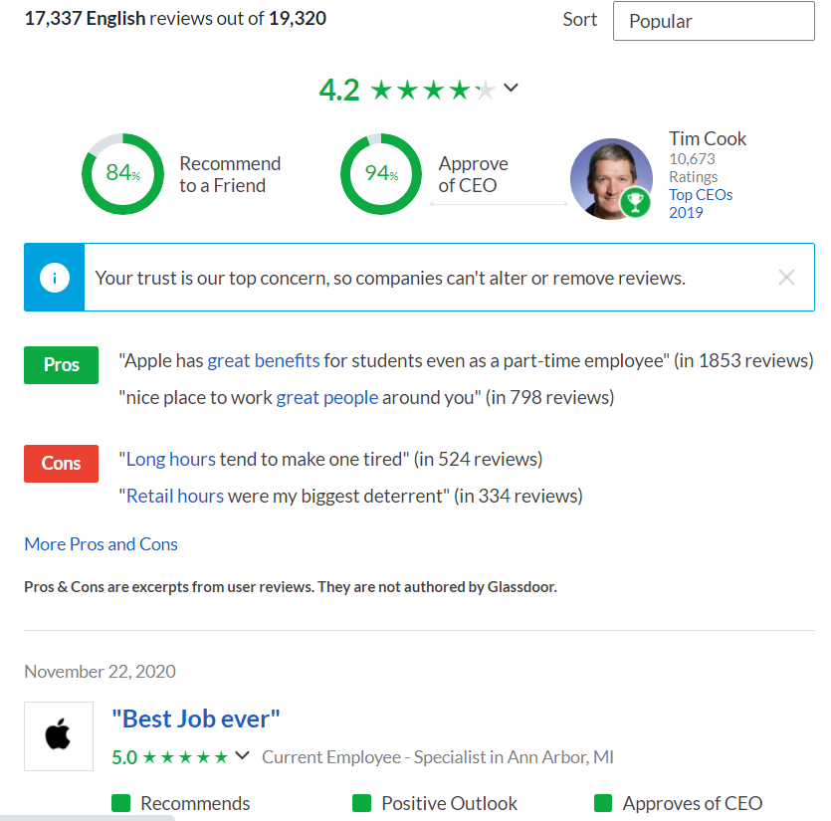
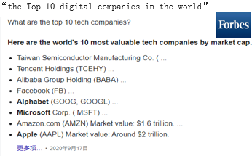
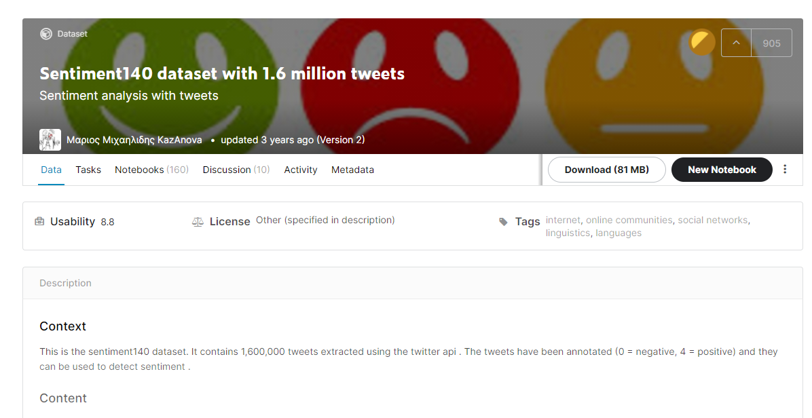
2/7 Dataset How we get the data?
employees’ comments - glassdoor.com
public’s comments – tweets-kaggle
Notes:
We constructed our dataset by extracting two kinds of data. The first one is employee’s comments from glassdoor,
and the second one is the tweets dataset from Kaggle.

Slide 6
3/7 Data Cleaning Tweets data
Since the comments on glassdoor is already cleaned,
so I will emphasize handling the tweets dataset.
Notes:
Since the comments on glassdoor is already cleaned, I will focus on introducing the data cleaning process of tweets dataset.

Slide 7
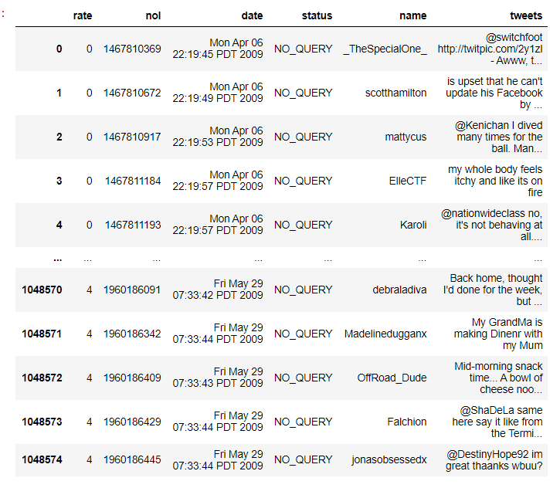
3/7 Data Cleaning A glimpse at our data
First, have a look at the data
Notes:
Our data has 6 columns, but the only one which is valuable for us is the last column. And it has many punctuations like @(at sign) #(hash key), so we will drop these meaningless punctuations later in the data preprocessing part.

Slide 8
3/7 Data Cleaning Common steps
Numerical data:
Removing null values / duplicate data
outliers
Notes:
When dealing with numerical data, data cleaning often involves removing null values and duplicate data, dealing with outliers, etc. With text data, there are some common data cleaning techniques, which are also known as text pre-processing techniques.

Slide 9
3/7 Data Cleaning Common steps
Text data: this cleaning process can go on forever.
MVP (minimum viable product) approach
Notes:
With text data, this cleaning process can go on forever. There's always an exception to every cleaning step.
So, we have to follow a specific rule, in this project, we chose the MVP (minimum viable product) approach - start simple and iterate.

Slide 10
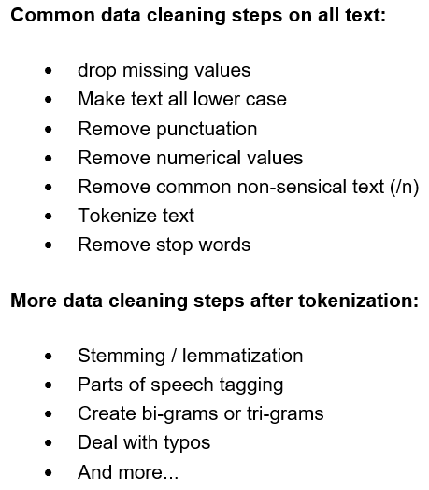
3/7 Data Cleaning Common steps
Notes:
Here are a bunch of things you can do to clean your data.
We‘re going to execute just the common cleaning steps here, like this (click) and the rest can be done at a later point to improve our results.

Slide 11
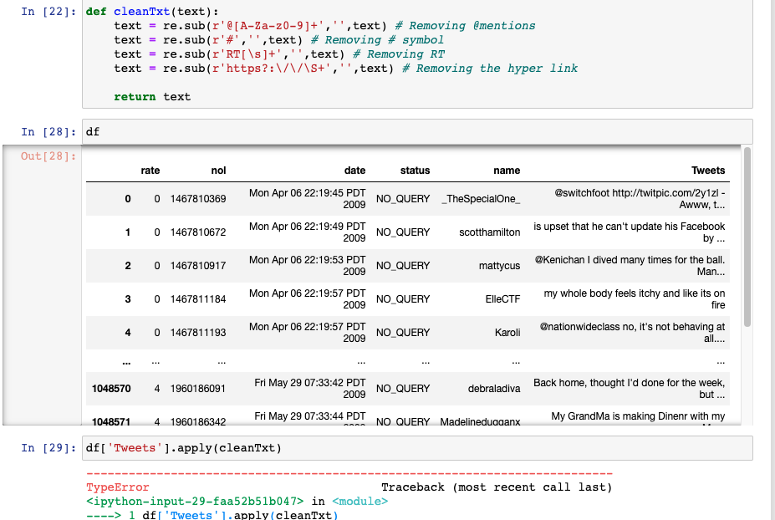
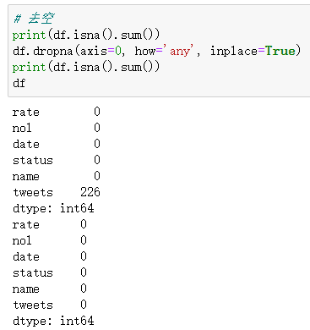
3/7 Data Cleaning
1. Drop the missing values
If not
TypeError: expected string or bytes-like object
Notes:
The first step of data cleaning is to drop the missing values, if we ignore this procedure, the program will raise an error, like which is shown on the right graph.

Slide 12
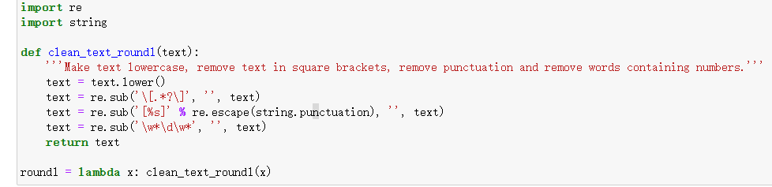
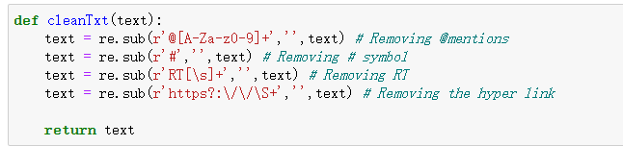
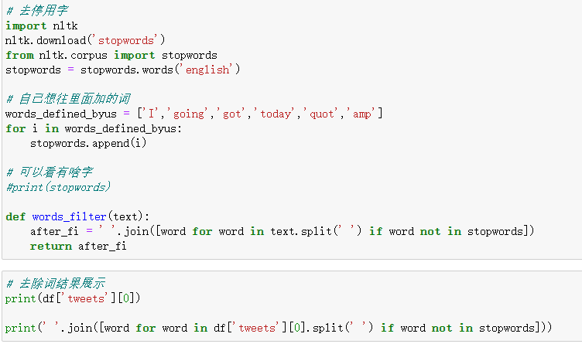
3/7 Data Cleaning
2. Trans to lower case
3. Removed punctuations / numbers / https
4.Tokenize and remove stopwords
Notes:
After that, we transfer our words into lower case. Then removed punctuations and numbers, and hyperlinks. One interesting thing here is that we should remove stop words, we used a normal stop words dataset to do it first, and we can remove other stop words by checking the result.

Slide 13
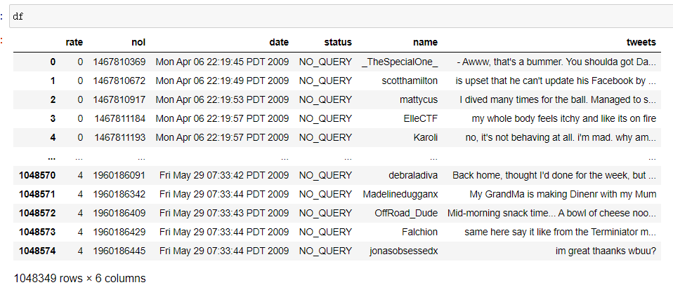
3/7 Data Cleaning
Now the data looks so much better!
Notes:
Here is the cleaned dataset. Looks so much better, right?

Slide 14
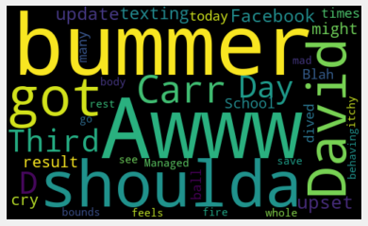
3/7 Data Cleaning Check by drawing a word cloud
We draw a word cloud to see if there are any other meaningless words that we need to remove
Notes:
On that basis, we can draw a word cloud to show some common words. As can be seen, there are some meaningless words such as “got”. So, we should go back to the stop words removal part to fix the problem.

Slide 15
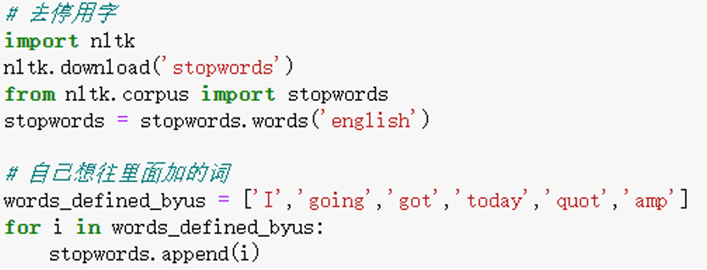
3/7 Data Cleaning Remove other meaningless words
So we added some stop words to the general English stop words.
Notes:
Besides using the common stop words dataset, we created a list to add the stop words we want, literately, customize the stop words dataset.

Slide 16
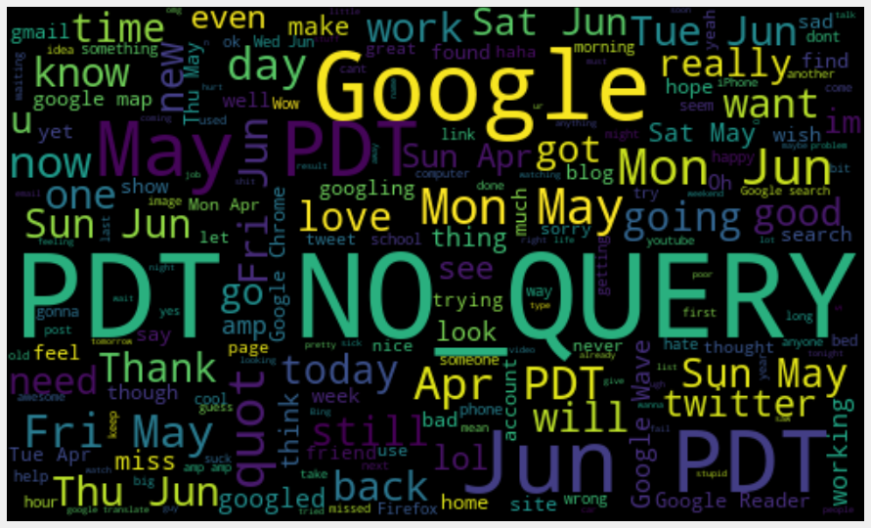
3/7 Data Cleaning
And then, we draw a world cloud about Google
16
Notes:
And then, we can run the word cloud of the aforementioned tech companies, Microsoft, Google,
Apple etc. Here is an example of a world cloud of tweets relating to Google.

Slide 17
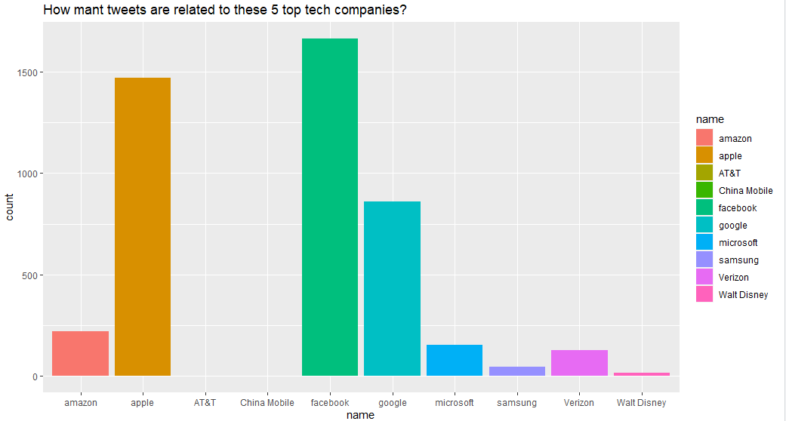
4/7 Select relevant data
Tech giants’ common point1: Popular on social media
17
Notes:
After data cleaning, we selected relevant tweets about tech companies using “sqldf”. Then, we visualized the numbers of tweets relating to each company.
According to the bar graph, we find out our first piece of conclusion about the tech giants, they are often talked about by people on social media.

Slide 18
5/7 Topic modeling LDA + tf-idf
Topic modeling is an unsupervised machine learning technique that’s capable of scanning a set of documents, detecting word and phrase patterns within them, and automatically clustering word groups and similar expressions that best characterize a set of documents.
Tweets about tech companies
Topic modeling
services?
products?
prices?
18
Notes:
The next part is the core of presentation, the topic modeling part using python. Topic modeling is an unsupervised machine learning tech which aims to cluster sentence into different groups.
For this project, we try to split tweets about tech companies into various clusters and want to figure out what those clusters stands for.

Slide 19
5/7 Topic modeling LDA + tf-idf in Python
First, we calculated the tf-idf to choose important words from the topics.
from sklearn.feature_extraction.text import CountVectorizer, TfidfVectorizer
tfidf_model_lda = CountVectorizer(max_df=0.99, max_features=500, min_df=0.01, stop_words='english', tokenizer=tokenization_and_stemming, ngram_range=(1, 1)) tfidf_matrix_lda = tfidf_model_lda.fit_transform(data) # fit the vectorizer to synopses
Then, we use a LDA for clustering the comments into 5 topics.
from sklearn.decomposition import LatentDirichletAllocation
# Topic Modeling - Latent Dirichlet Allocation: # use LDA for clustering: lda = LatentDirichletAllocation(n_components=5)
19
Notes:
First we calculated the ti-idf of the data and then use LDA to split the data into five topics.

Slide 20
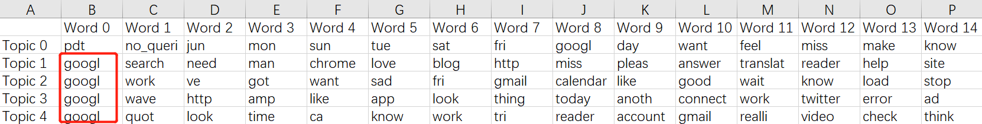
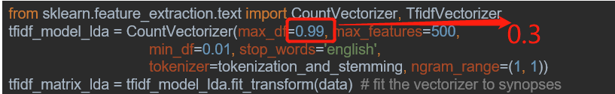
5/7 Topic modeling LDA + tf-idf result
Our result about tweets relating to google:
Not ideal, so I lowered the max_df to filter these frequent words like “googl”
20
Notes:
Unfortunately, the result here is not as meaningful as we expect. Then we tried to fix this by changing the parameters like max_df, which will filter out the frequent words, from 0.99 to 0.3.

Slide 21
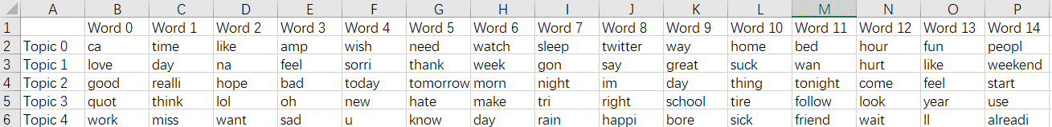
5/7 Topic modeling After adjusting the parameter
Though there’re no “googl” now,
The topic modeling result is still not very ideal……
21
Notes:
Here is the result we got after adjusting. However, it is still not that great.

Slide 22
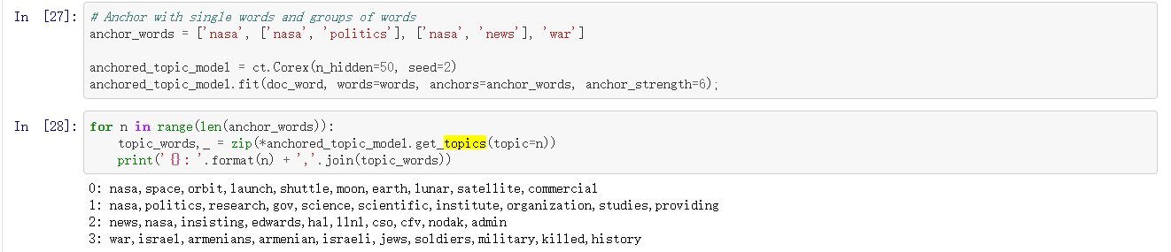
5/7 Topic modeling result analysis
So I searched on the internet, I found that LDA performs bad in short passages. Biterm Topic Model
performs better. So we will try that next time.
And we can do the topic modeling with domain expertise
We will try that in the future!!
Anchored CorEx: Topic Modeling with Minimal Domain Knowledge, 2017
22
Notes:
The possible explanation is that the tweets are often short, repetitive, and full of abbreviation, so that words appear many times as key words in different groups. Searching on the internet, we found a better model which is biterm topic model to solve the problem. Besides, we can use anchored CorEx which considers the domain expertise when doing topic modeling. Here is its core codes. And it has a good result on the newspaper dataset. Like the war and Israel are divided into the same topic. So we may use it in the future project to test its performance.

Slide 23
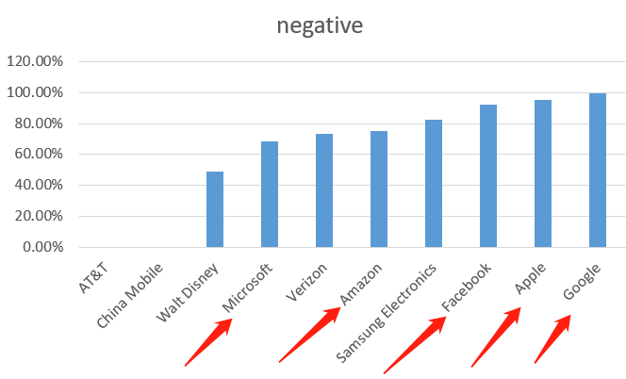
6/7 Sentiment analysis public’s comments on tweets
When a company gets bigger, it must bear some bad reviews on the Internet
23
Notes:
The second part is about sentiment analysis using R. First, we calculated the negative rates of tweets relating to tech company. Surprisingly, we find that when a company becoming larger, its negative comments often grow at the same time.

Slide 24
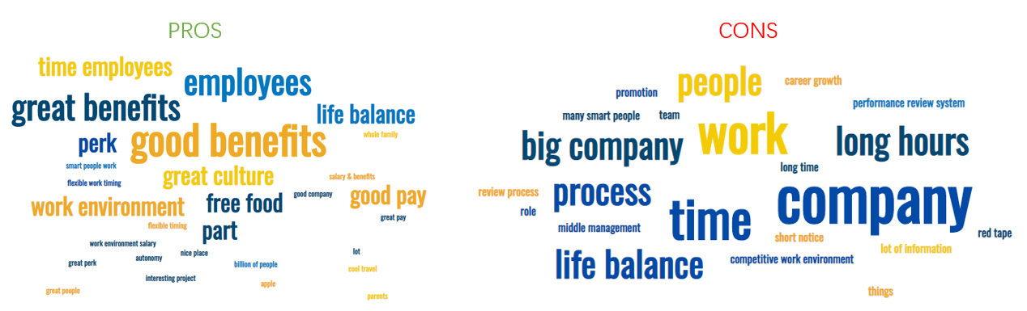
6/7 Sentiment analysis employee’s comments on glassdoor
Word cloud for positive and negative comments
24
Notes:
We first classified the sentence into negative and positive sentence, and for each type of comment we drew a word cloud.

Slide 25
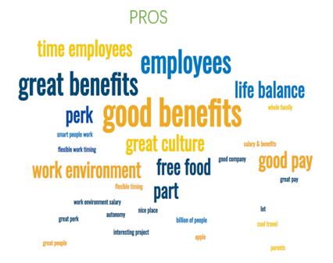
6/7 Sentiment analysis employee’s comments on glassdoor
Positive comments about the top 5 tech giants
Common points:
“Good benefits”
“Great culture”
“work environment”
25
Notes:
For positive comments, the representative words are like ‘good profits’, ‘great culture’, ‘challenges’, and ‘life balance’. Those words picture a lucrative, humanitarian company.

Slide 26
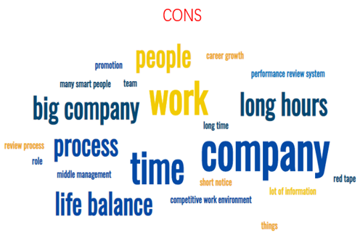
6/7 Sentiment analysis employee’s comments on glassdoor
Negative comments about the top 5 tech giants
Common points:
“long hours”—Maybe they are not 996, still tiring
“Many smart people, hard for career growth”
“competitive work enviroment”
26
Notes:
While for negative comments, the key words are full of smart people and hard to move up, which means the company is very competitive inside.

Slide 27
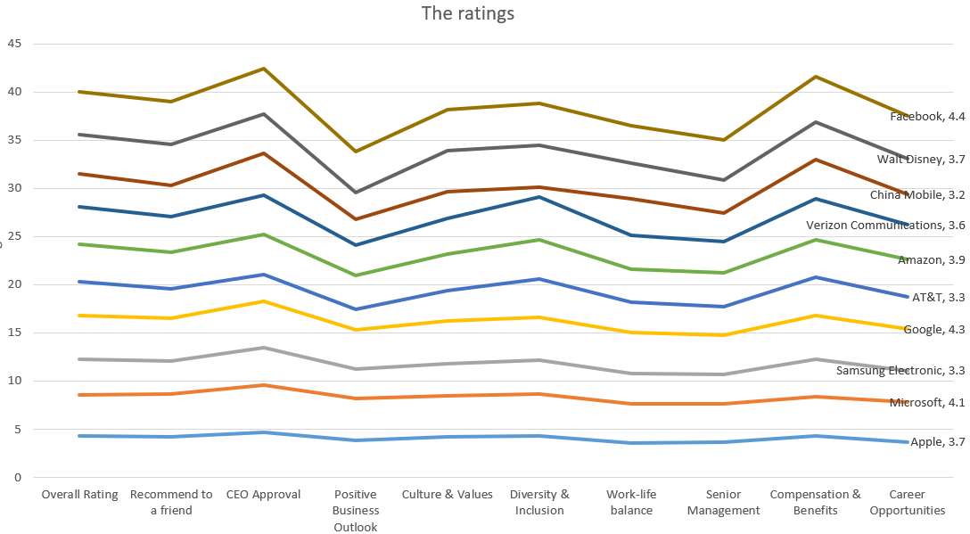
6/7 Sentiment analysis employee’s comments on glassdoor
A numerical way to know what employees think about these companies
All of the rating is higher than 3.5
27
Notes:
In addition, we plot the ratings for each company and we found that all of the ratings are higher than 3.5 and facebook is absolute the best of best.

Slide 28
7/7 conclusion The tech giants’ common points
The tech giants’ common points:
1. popular in social media
(Even though many of them are negative)
2.enjoy high reputation among the employees.
(higher than 3.5 on glassdoor)
28
Notes:
To sum up, we summarized the common points of high tech companies which includes popular in social media, high reputation among employees and great challenges inside the company.

Slide 29

7/7 conclusion
Which company may become the next tech giants?
1.Verizon
Reasons:
Popular in social media
Enjoys a high reputation among employees
29
Notes:
So, to build a giant company, first try to achieve those two points. I believe Verizon may become the next tech giant.

Slide 30
7/7 conclusion
Cf R and Python in NLP
 | Python | R
pros | Many docs and projects for reference | More interactive
cons | Nope | Contradicts to Python’s pros
30
Notes:
Meanwhile, we compare nlp in python and R. For python, the biggest strength is that there are so many projects as reference which guide us perfectly. While for R, the advantage is that its more interactive but since less people use R to for nlp, we cannot find as many reference as possible

Slide 31
Thank you.
Notes:
Overall, those are the work we did this week, and thanks for listening.

